Slide 1
Project scheduling

Slide 2
Schedule representation
Graphical notations are normally used to illustrate the project schedule.
These show the project breakdown into tasks. Tasks should not be too small. They should take about a week or two.
Bar charts are the most commonly used representation for project schedules. They show the schedule as activities or resources against time.

Slide 3
Tasks, durations, and dependencies
Task | Effort (person-days) | Duration (days) | Dependencies
T1 | 15 | 10
T2 | 8 | 15
T3 | 20 | 15 | T1 (M1)
T4 | 5 | 10
T5 | 5 | 10 | T2, T4 (M3)
T6 | 10 | 5 | T1, T2 (M4)
T7 | 25 | 20 | T1 (M1)
T8 | 75 | 25 | T4 (M2)
T9 | 10 | 15 | T3, T6 (M5)
T10 | 20 | 15 | T7, T8 (M6)
T11 | 10 | 10 | T9 (M7)
T12 | 20 | 10 | T10, T11 (M8)

Slide 4
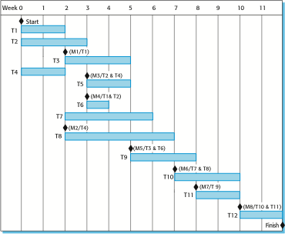
Activity bar chart

Slide 5
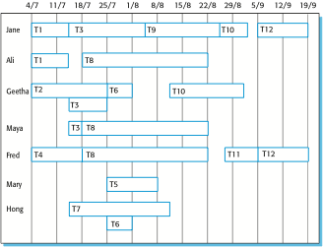
Staff allocation chart

Slide 6
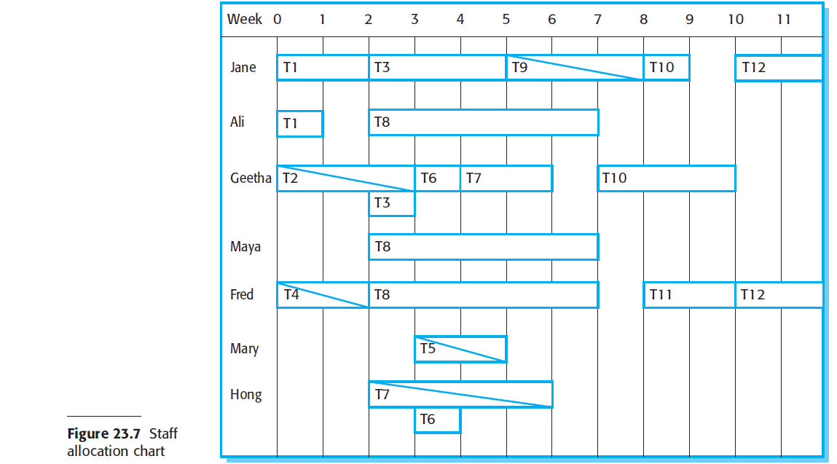

Slide 7
END

